Slide 1
Local Area Networks

Slide 2
Local Area Network
A Local area Network is the data communication system that allows a number of independent devices to communicate directly with each other in a limited geographical area.
LANs are dominated by four architecture:
Ethernet
Token Bus
Token Ring
Fiber distributed data interface
Token Bus, Token Ring and Ethernet are standards of IEEE and a part of project 802.

Slide 3
Project 802
The computer society of the IEEE started a project, called 802 to set up standards to enable intercommunication between equipment from a variety of manufacturers.
Concentrates on standards that describe a network’s physical elements.
NICs, cables, connectors, signalling technologies, media access control, and the like.
Project 802 does not seek to replace any part of the OSI model.
The IEEE has subdivided the data link layer into sub layers:
Logical link control(LLC)
Medium access control(MAC)

Slide 4
Project 802 (cont.)
The LLC is non architecture specific, that is the same for all IEEE defined LANs.
The MAC sublayer on the other hand, contains a number of distinct modules, each carries proprietary information specific to the LAN product being used.
The strength of project 802 is modularity.
By subdividing the function necessary for LAN management, the designers were able to standardize those that can be generalized and to isolate those that must remain specific.

Slide 5
Project 802 (cont.)
Each sub division is identified by a number:
802.1 (Internetworking)
802.2 (LLC)
802.3 (MAC)
802.4 (Token Bus)
802.5 (Token Ring)

Slide 6
LAN compared with OSI model

Slide 7
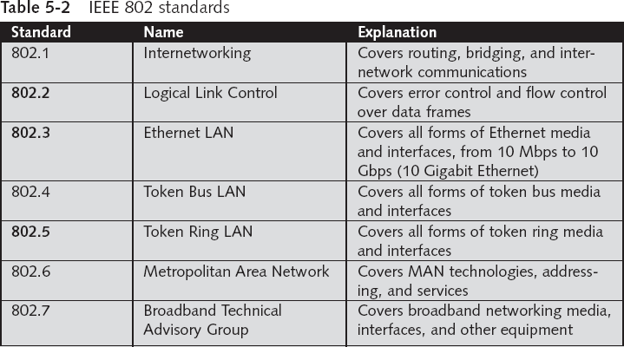
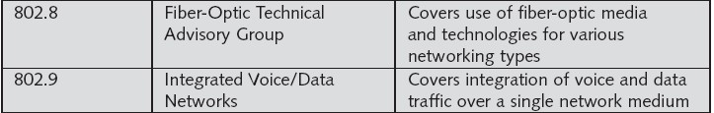
IEEE 802 SPECIFICATION

Slide 8
IEEE 802.1
IEEE 802.1 is the section of Project 802 devoted to internetworking issues in LANs and MANs.
It seeks to resolve the incompatibilities between network architectures without requiring modifications in existing addressing access and error recovery mechanisms, among others.

Slide 9
Logical Link Control
The IEEE project 802 model takes the structure of an HDLC frame and divides it into two sets functions.
One set contains the end user portions of the frame:
The logical address
Control Information
Data
These functions are handled by the IEEE 802.2 logical link control protocol.
IEEE 802.2 logical link control is the upper sub layer of the data link layer.

Slide 10
Medium Access Control
The second set of functions, the MAC sub layer, resolves the contention for the shared media.
It contains the synchronization, flag, flow, and error control specifications necessary to move information from one place to another as well as the physical address of the next station to receive and route packet.
MAC is the lower sub layer of the data link layer.

Slide 11
LAN compared with OSI model

Slide 12
Protocol Data Unit (PDU)
The data unit in the LLC level is called the PDU.
The PDU contains four fields familiar from HDLC:
Destination Services Access Point (DSAP)
Source Service Access Point (SSAP)
Control Field
Information Field

Slide 13
DSAP and SAP
The DSAP and SSAP are addresses used by the LLC to identify the protocol stacks on the receiving and sending machines that are generating and using the data.
The first bit of the DSAP indicates whether the frame in intended for an individual or a group.
The first bit of the SSAP indicates whether the communication is a command or response PDU.

Slide 14
Control field
The control field of the PDU is identical to the control field in HDLC.
As in HDLC, PDU frames can be I-frames, S-frames, or U-frames and carry all of the codes and information that the corresponding HDLC frames carry.

Slide 15
Ethernet
Ethernet is a family of computer networking technologies for local area networks (LANs) and metropolitan area networks (MANs). It was commercially introduced in 1980 and first standardized in 1983 as IEEE 802.3, and has since been refined to support higher bit rates and longer link distances.
Over time, Ethernet has largely replaced competing wired LAN technologies such as token ring, FDDI, and ARCNET

Slide 16
Ethernet CSMA/CD
CSMA/CD (carrier sense multiple access with collision detection) media access protocol is used.
Data is transmitted in the form of packets.
Sense channel prior to actual packet transmission.
Transmit packet only if channel is sensed idle; else, defer the transmission until channel becomes idle.
After packet transmission is started, the node monitors its own transmission to see if the packet has experienced a collision.
If the packet is observed to be undergoing a collision, the transmission is aborted and the packet is retransmitted after a random interval of time using Binary Exponential Backoff algorithm.

Slide 17
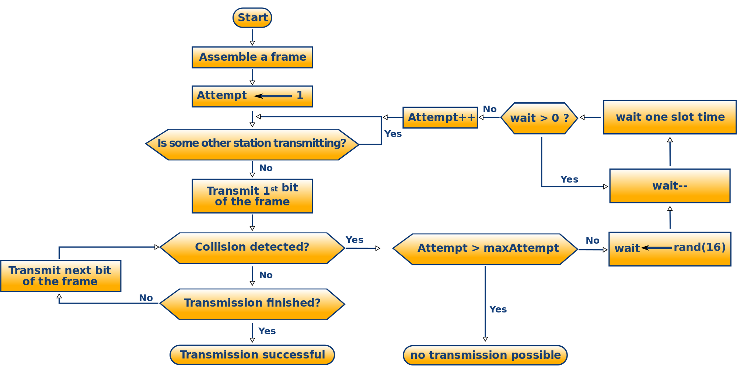
Ethernet CSMA/CD flowchart

Slide 18
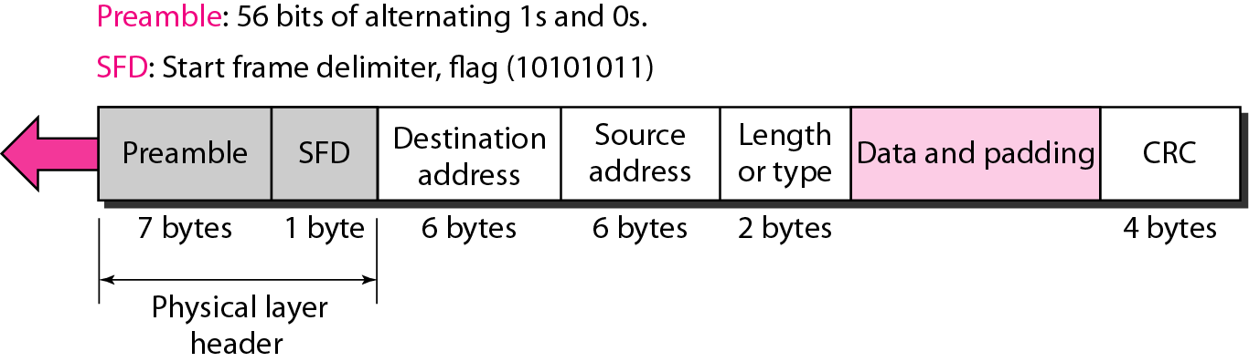
802.3 MAC frame

Slide 19
802.3 MAC frame
PREAMBLE: The first field of the 802.3 frame contains 7 bytes(56bits )of alternating 0s and 1s that alerts the receiving system to coming frame and enables it to synchronize its input timing.
START FRAME DELIMITER(SFD): The second field (1byte:10101011)signals the beginning of the frame . The SFD warns the station that this is the last chance for synchronization . The last 2 bits is11 and alerts the receive that the next field is the destination address.
DESTINATION ADDRESS(DA): The DA field is 6bytes and contain the physical address of the destination station to receive the packet
SOURCE ADDRESS: The SA field is also 6 bytes and contains the physical address of the sender of the packet.
LENGTH/TYPE: This field is defined as a type field or length field. The original Ethernet used this field as the type field to define the upper –layer protocol using the MAC frame.
DATA: This field carries data encapsulated from the upper –layer protocols. It is a minimum of 46 and a maximum of 1500 bytes.
CRC: The last filed contains error detection information, in this case a CRC-32.

Slide 20
IEEE Ethernet
In IEEE 802.3 Ethernet Data link layer is split into two sublayers:
Bottom part: MAC
The frame is called IEEE 802.3
Handles framing, MAC addressing, Medium Access control
Specific implementation for each LAN protocol
Defines CSMA/CD as the access method for Ethernet LANs and Token passing method for Token Ring.
Implemented in hardware
Top part: LLC (Logical Link Control)
The sub frame is called IEEE 802.2
Provides error and flow control if needed
It makes the MAC sublayer transparent
Allows interconnectivity between different LANs data link layers
Used to multiplex multiple network layer protocols in the data link layer frame
Implemented in software

Slide 21
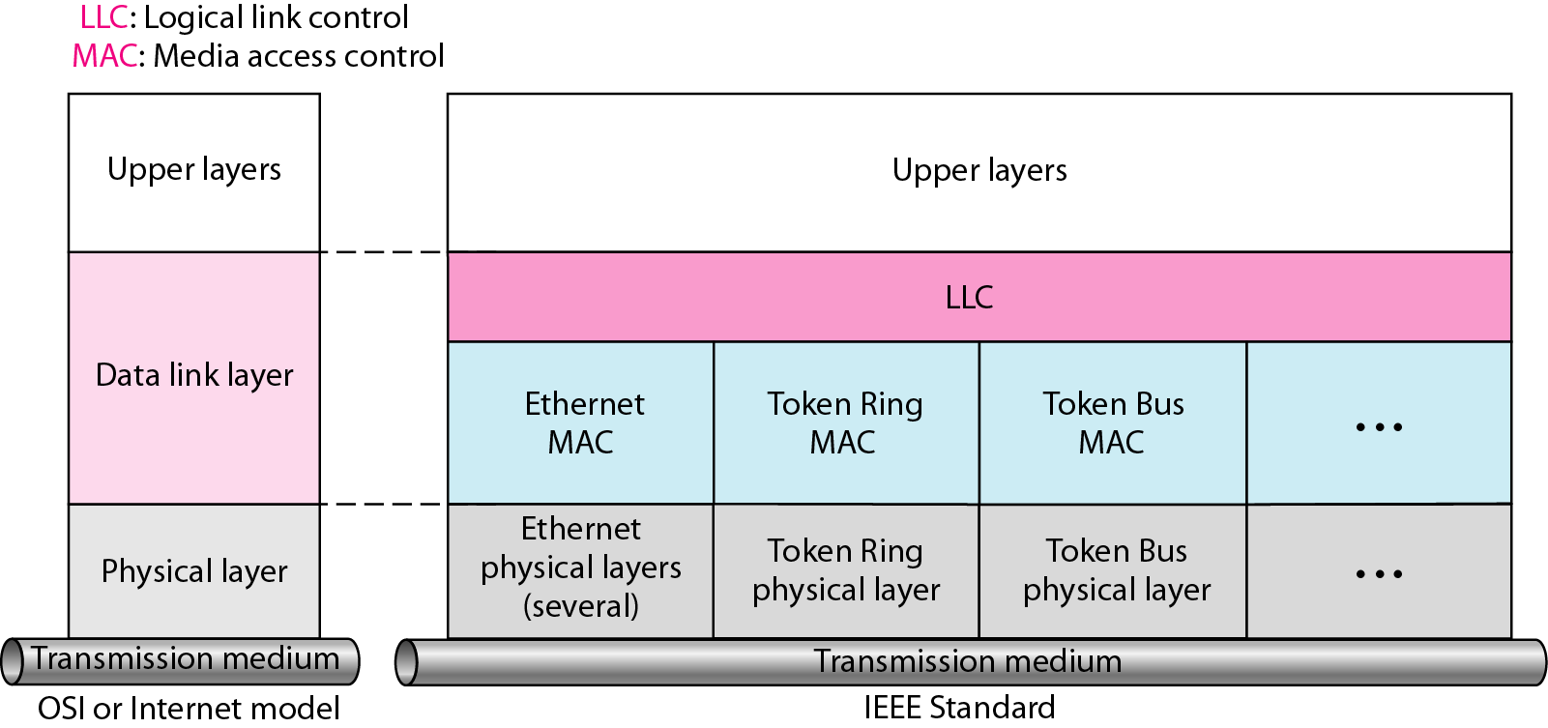
IEEE standard for LANs

Slide 22
Ethernet Provides Unreliable, connectionless Service
Ethernet data link layer protocol provides connectionless service to the network layer
No handshaking between sending and receiving adapter.
Ethernet protocol provides Unreliable service to the network layer :
Receiving adapter doesn’t send ACK or NAK to sending adapter
This means stream of datagrams passed to network layer can have gaps (missing data)
Gaps will be filled if application is using reliable transport layer protocol
Otherwise, application will see the gaps

Slide 23
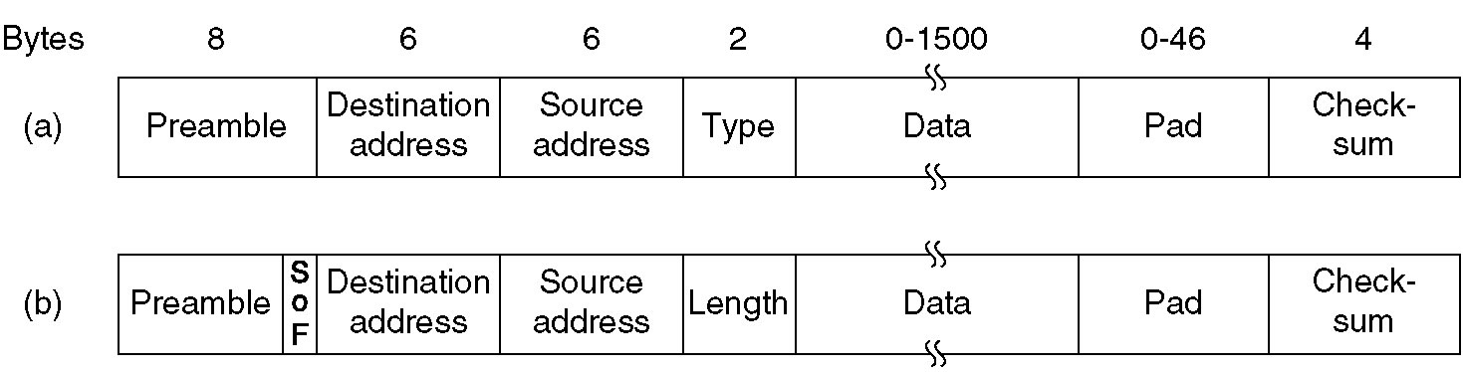
Ethernet Frame format
FCS
FCS
Frame formats. (a) DIX Ethernet , (b) IEEE 802.3.

Slide 24
Ethernet Frame format (cont.)
Preamble:
8 bytes with pattern 10101010 used to synchronize receiver, sender clock rates.
In IEEE 802.3, eighth byte is start of frame (10101011)
Addresses: 6 bytes (explained latter)
Type (DIX):
Indicates the type of the Network layer protocol being carried in the payload (data) field, mostly IP but others may be supported such as IP (0800), Novell IPX (8137) and AppleTalk (809B), ARP (0806) )
Allow multiple network layer protocols to be supported on a single machine (multiplexing)
Its value starts at 0600h (=1536 in decimal)

Slide 25
Ethernet Frame format (cont.)
Length (IEEE 802.3): number of bytes in the data field.
Maximum 1500 bytes (= 05DCh)
CRC: checked at receiver, if error is detected, the frame is discarded
CRC-32
Data: carries data encapsulated from the upper-layer protocols
Pad: Zeros are added to the data field to make the minimum data length = 46 bytes.

Slide 26
ADDRESSING
Each station on a Ethernet network(such as PC ,workstation or printer) has its own network interface card(NIC).The NIC fits inside the station and provides the station with a 6-byte physical address . The Ethernet address is 6bytes(48 bits)written in hexadecimal notation , with a colon between the bytes.
Example:
06:01:02:01:2C:4B
6 bytes =12 hex digits = 48 bits
UNICAST AND MULTICAST

Slide 27
ADDRESSING (cont.)
The least significant bit of the first byte defines the type of address . If the bit is 0 ,the address is unicast ; otherwise , it is multicast.
A unicast address defines only one recipient ; the relationship between the sender and the receiver is one-to-one.
A multicast address defines a group of addresses ; the relationship between the sender and the receiver is one-to-many.
The broadcast destination address is a special case of the multicast address in which all bits are 1s.

Slide 28
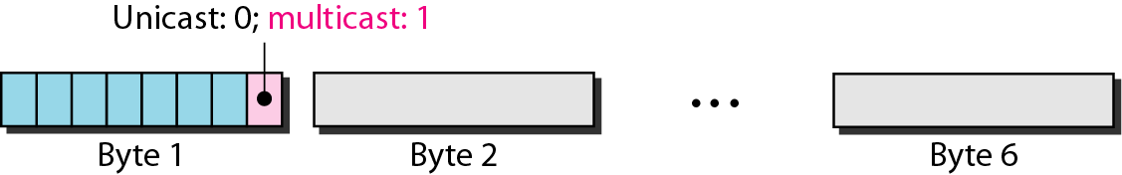
Unicast and multicast addresses

Slide 29
Example 1
Show how the address 47:20:1B:2E:08:EE is sent out on line.
Solution:
The address is sent left-to-right, byte by byte; for each byte, it is sent right-to-left, bit by bit, as shown below:

Slide 30
Example 2
Define the type of the following destination addresses:
a. 4A:30:10:21:10:1A b. 47:20:1B:2E:08:EE
FF:FF:FF:FF:FF:FF
Solution:
To find the type of the address, we need to look at the second hexadecimal digit from the left. If it is even, the address is unicast. If it is odd, the address is multicast. If all digits are F’s, the address is broadcast. Therefore, we have the following:
a. This is a unicast address because A in binary is 1010.
b. This is a multicast address because 7 in binary is 0111.
c. This is a broadcast address because all digits are F’s.

Slide 31
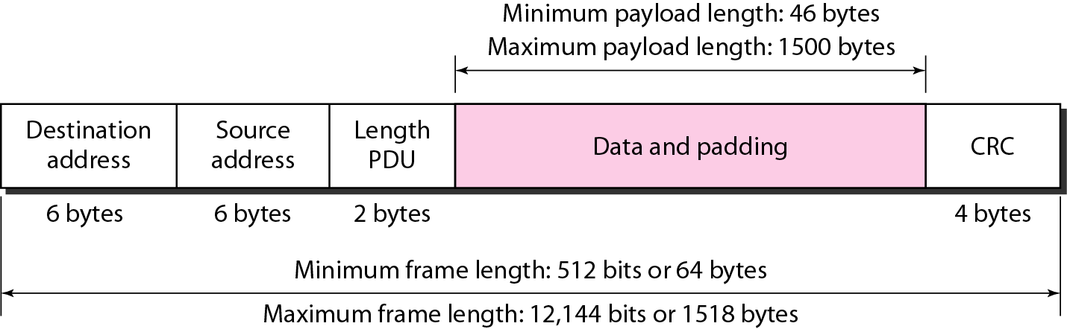
Minimum and maximum lengths
Frame length:
Minimum: 64 bytes (512 bits) Maximum: 1518 bytes (12,144 bits)

Slide 32
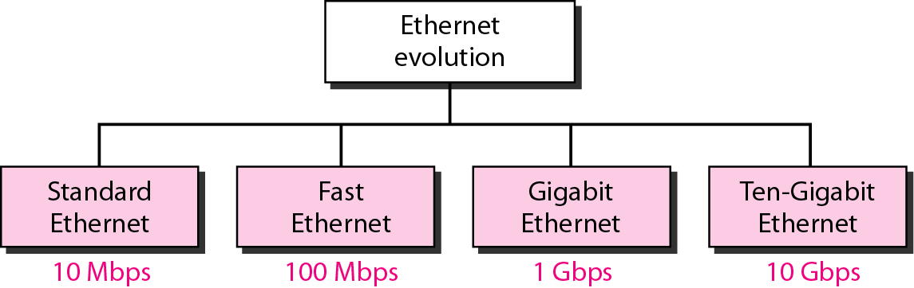
Ethernet evolution through four generations

Slide 33
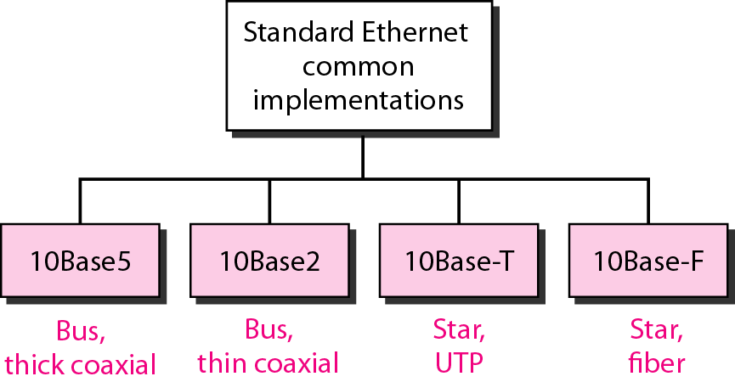
Categories of traditional Ethernet

Slide 34

Categories of traditional Ethernet
<data rate><Signalling method><Max segment length or cable type>

Slide 35
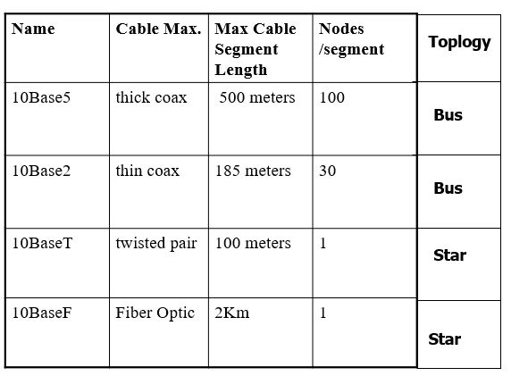
IEEE 802.3 Cable Types

Slide 36
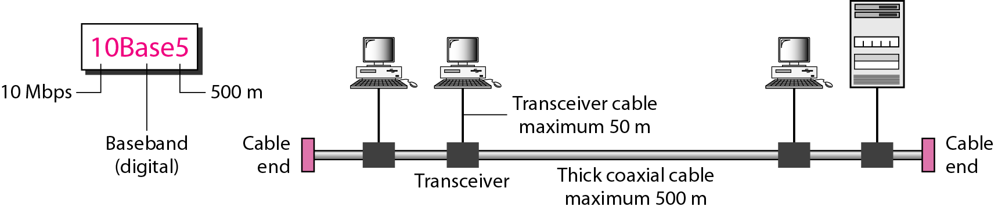
10Base5 implementation
The name 10Base5 is derived from several characteristics of the physical medium. The 10 refers to its transmission speed of 10 Mbit/s. The BASE is short for baseband signalling as opposed to broadband, and the 5 stands for the maximum segment length of 500 meters (1,600 ft.).
It was the first Ethernet specification to use a bus topology with a external transceiver connected via a tap to a thick coaxial cable.

Slide 37
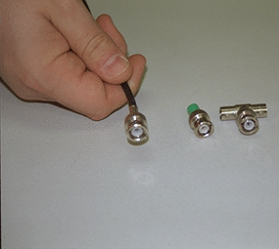
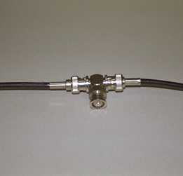
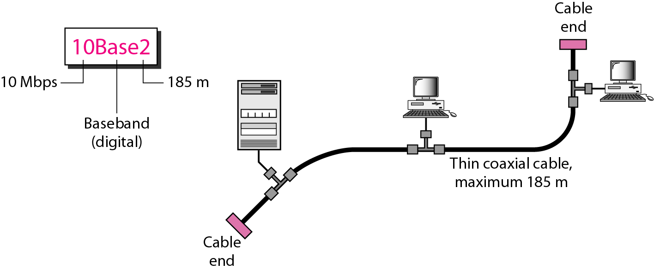
10Base2 implementation

Slide 38
10Base2 implementation (cont.)
The second implementation is called 10Base2, thin Ethernet , cheaper net.
The cable is thinner and more flexible.
The transceiver is a part of NIC , which is installed inside the station.
The implementation is most cost effective than 10Base5as thin coaxial cable is less expensive than thick coaxial cable and the tee connection are much cheaper than taps.

Slide 39
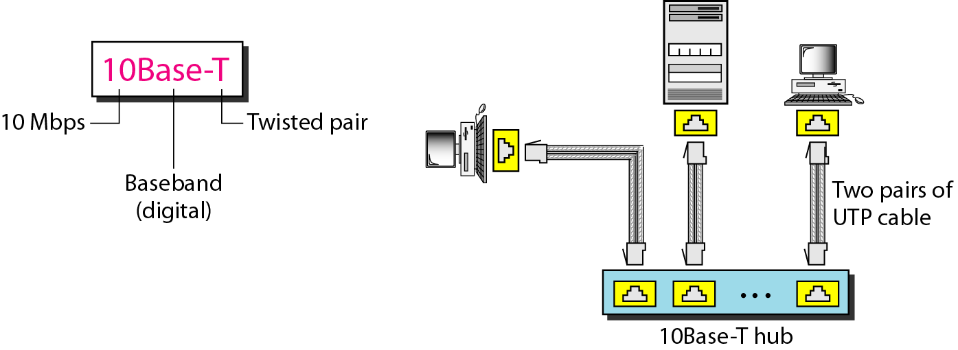
10BaseT implementation
The third implementation is called 10Base- T or Twisted Pair Ethernet.
It uses star topology and the station are connected via two pairs of twisted cable(one fro sending and one for receiving)between the station and the hub.
The maximum length of the twisted cable here is defined as 100m,to minimize the effect of attenuation in the twisted cable.

Slide 40
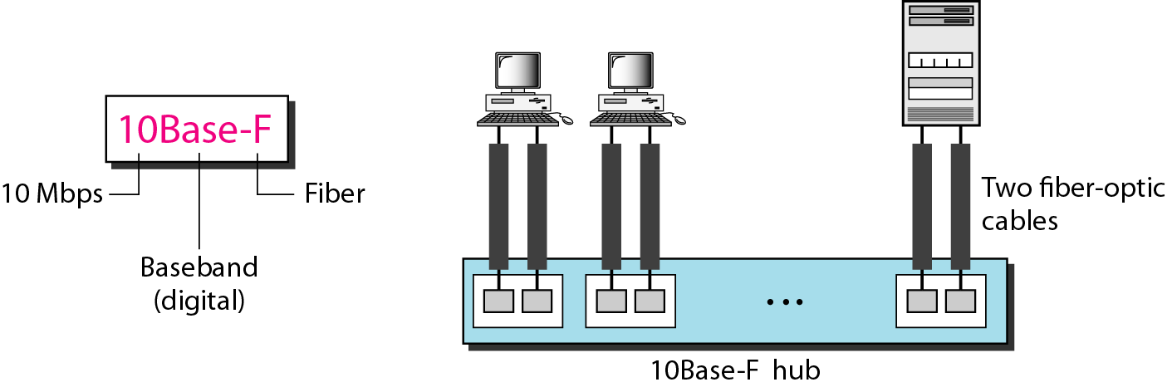
10BaseF implementation
Although there are several types of optical fiber 10Mbps Ethernet, the most common is called 10Base-F.
10Base-F uses a star topology to connect stations to a hub.
The stations are connected to a hub using two-optic cables.

Slide 41
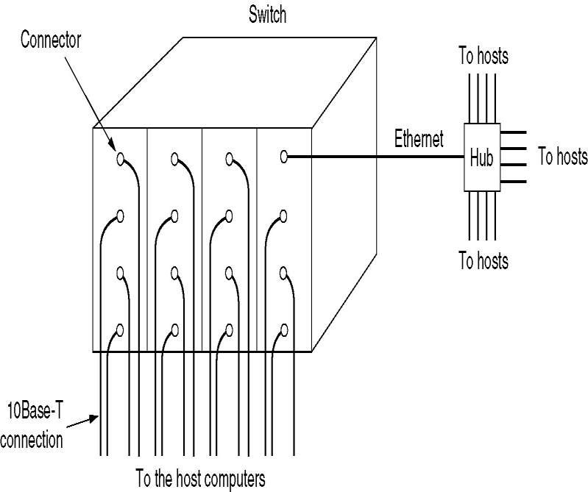
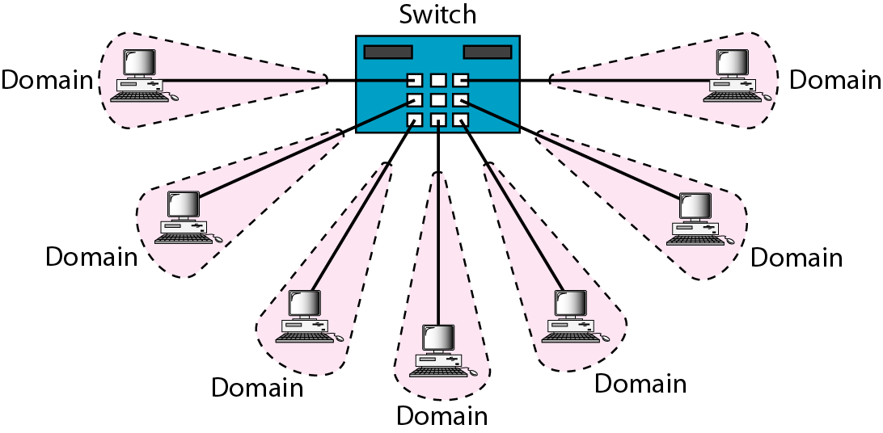
Switched Ethernet
The heart of the system is a switch containing a high speed back-plane and room for typically 4 to 32 plug-in cards, each containing one to eight connectors.
When a station wants to transmit a frame, it outputs a frame to switch. The plug-in card checks to see if the frame is for the other station on the same card.
If so, it is copied there otherwise it is sent over high speed back-plane to destination station’s card.

Slide 42
Switched Ethernet (cont.)
What happens if two machines attached to the same plug-in card transmit frames at the same time?
It depends in how the card is constructed. All ports on the same card are wired together to form a local on-card LAN.
Collisions on this on-card LAN are detected and handled using CSMA/CD protocol.
One transmission per card is possible at any instant.
All the cards can transmit in parallel. With this design each card forms its own collision domain.
In other design, each input port is buffered, so incoming frames are stored in the card’s on board RAM.
It allows all input ports to receive(and transmit) frame at same time.

Slide 43
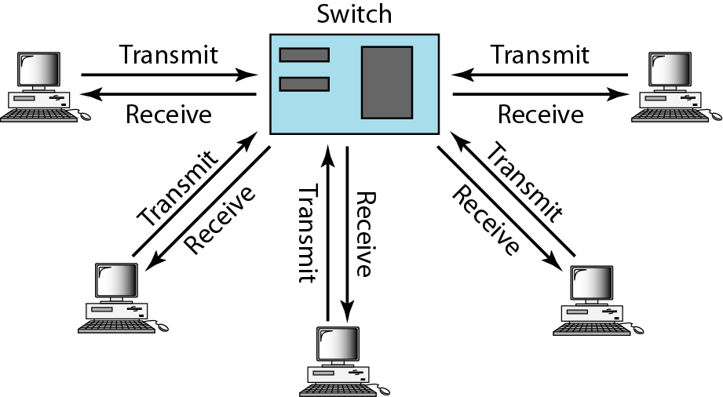
Full-duplex switched Ethernet
Traditional Ethernet is half duplex
Either transmit or receive but not both simultaneously
With full-duplex, station can transmit and receive data simultaneously
With full duplex, Throughput (actual transmission rate) is doubled.
10-Mbps Ethernet in full-duplex mode, theoretical transfer rate becomes 20 Mbps
100-Mbps Ethernet in full-duplex mode, theoretical transfer rate becomes 200 Mbps

Slide 44
Full-duplex switched Ethernet (cont.)
Changes that should be made with any computer in order to operate in Full-Duplex Mode
Attached stations must have full-duplex NIC cards
Must use two pairs of wire one pair for transmitting from host to switch (inbound) and the other pair for transmitting from switch to host (outbound)
Must use a switch as a central device not a hub
Devices must be connected point-to-point (dedicated) to the switch
Each station constitutes separate collision domain
CSMA/CD algorithm no longer needed (no collision)
No limit on the segment length
Same 802.3 MAC frame format used

Slide 45
Fast Ethernet
It was designed to compete with LAN protocols such as FDDI or Fiber channel . IEEE created Fast Ethernet under the name 802.3u.Fast Ethernet is backward-compatible with standard Ethernet , but it can transmit data 10 times faster at rate of100Mbps.
GOAL OF FAST ETHERNET:
Upgrade the data rate to 100Mbps.
Make it compatible with standard Ethernet.
Keep the same 48 bit-address.
Keep the same frame format.
Keep the same minimum and maximum frame lengths.

Slide 46
Fast Ethernet (cont.)
AUTONEGOTIATION:
It is a new feature is added to the Fast Ethernet . It allows a station or a hub a range of capabilities .
It was designed for the following purposes:
To allow incompatible devices to connect to one another.
To allow on devices to have multiple capabilities.
To allow a station to check a hub’s capabilities.

Slide 47
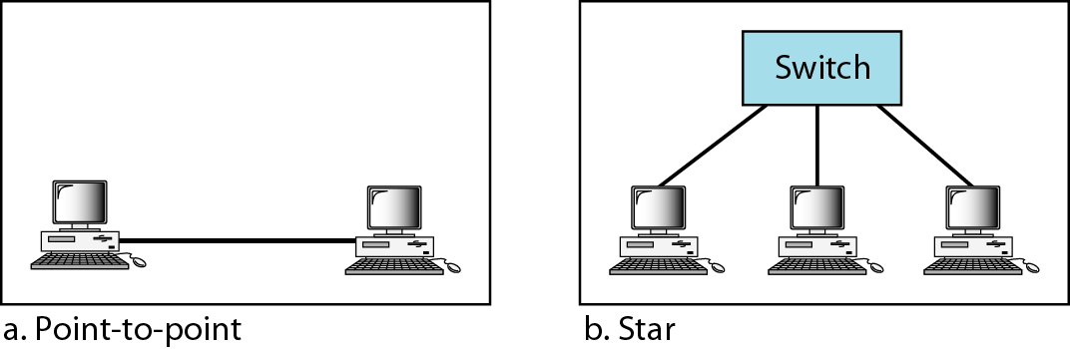
Fast Ethernet topology

Slide 48
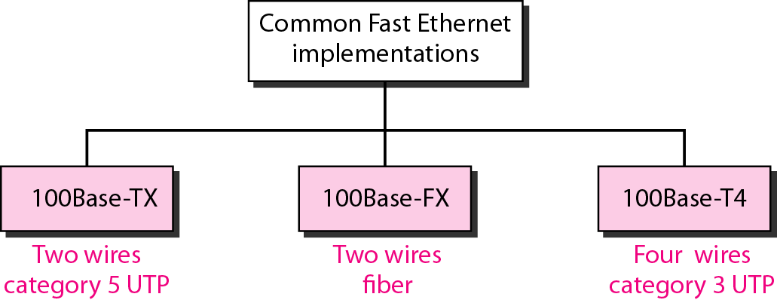
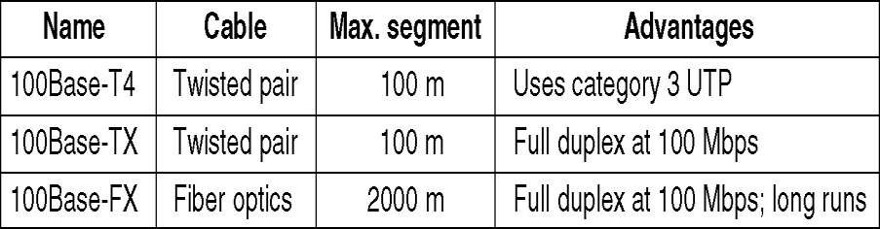
Fast Ethernet implementations
Bit rate is reduced to 10 ns from 100 ns.
Bit rate is reduced to 10 ns from 100 ns.

Slide 49
Gigabit Ethernet
In computer networking, Gigabit Ethernet (Gb E or 1 GigE) is a term describing various technologies for transmitting Ethernet frames at a rate of a gigabit per second (1,000,000,000 bits per second), as defined by the IEEE 802.3-2008 standard.
Gigabit Ethernet was the next iteration, increasing the speed to 1000 Mbit/s. The initial standard for Gigabit Ethernet was produced by the IEEE in June 1998 as IEEE 802.3z, and required optical fiber. 802.3z is commonly referred to as 1000BASE-X, where -X refers to either -CX, -SX, -LX, or (non-standard) -ZX. For the history behind the "X" see Fast Ethernet.

Slide 50
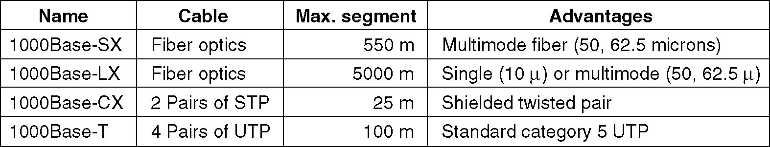
Gigabit Ethernet (cont.)
GOAL OF GIGABIT ETHERNET:
Upgrade the data rate to 1Gbps.
Make it compatible with standard or fast Ethernet.
Use the same address ,frame format.
Keep the same minimum and maximum frame length.
To support auto negotiation as defined in Fast Ethernet.
In the full-duplex mode of Gigabit Ethernet, there is no collision;
the maximum length of the cable is determined by the signal attenuation in the cable.

Slide 51
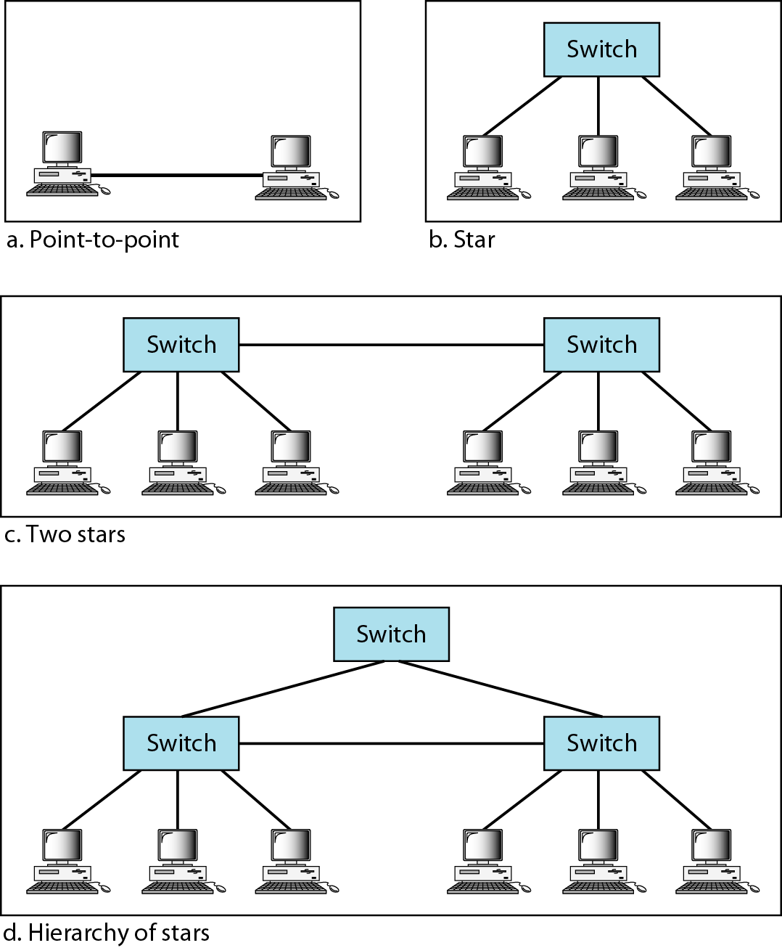
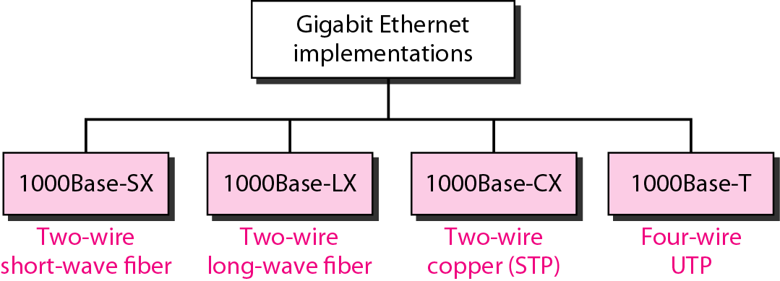
Implementations & Topologies of Gigabit Ethernet

Slide 52
10 Gig Ethernet
10 Gbps bandwidth.
Uses same CSMA/CD media access protocol as in Ethernet.
Propositioned for Metro-Ethernet
Maximum Segment Length
1000 Base-T - Not available
10GBase-LR - 10 Km (Single mode Fiber)
10GBase-ER - 40 Km (Single mode Fiber)

Slide 53
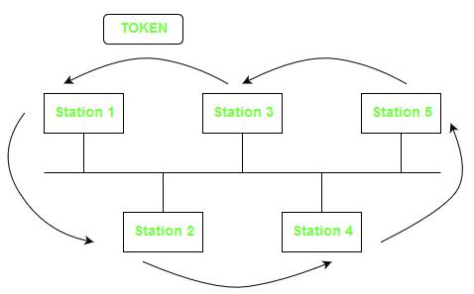
Token bus(802.4)
Token bus is a network implementing the token ring protocol over a "virtual ring" on a coaxial cable.[A token is passed around the network nodes and only the node possessing the token may transmit. If a node doesn't have anything to send, the token is passed on to the next node on the virtual ring. Each node must know the address of its neighbour in the ring, so a special protocol is needed to notify the other nodes of connections to, and disconnections from, the ring.
Token bus was standardized by IEEE standard 802.4. It is mainly used for industrial applications. The main difference is that the endpoints of the bus do not meet to form a physical ring.
Direction of Token

Slide 54
Token bus(802.4) (cont.)
Due to difficulties handling device failures and adding new stations to a network, token bus gained a reputation for being unreliable and difficult to upgrade.
In order to guarantee the packet delay and transmission in Token bus protocol, a modified Token bus was proposed in Manufacturing Automation Systems and flexible manufacturing system (FMS).
A means for carrying Internet Protocol over token bus was developed.
The IEEE 802.4 Working Group is disbanded and the standard has been withdrawn by the IEEE.

Slide 55
Token Ring(802.5)
The Token Ring network was originally developed by IBM in the 1970s. It is still in IBM's primary local-area network (LAN) technology. The related IEEE 802.5 specification is almost identical to and completely compatible with IBM's Token Ring network.
Token Ring and IEEE 802.5 networks are basically compatible, although the specifications differ in minor ways. IBM's Token Ring network specifies a star, with all end stations attached to a device called a multi station access unit (MSAU). In contrast, IEEE 802.5 does not specify a topology, although virtually all IEEE 802.5 implementations are based on a star.

Slide 56
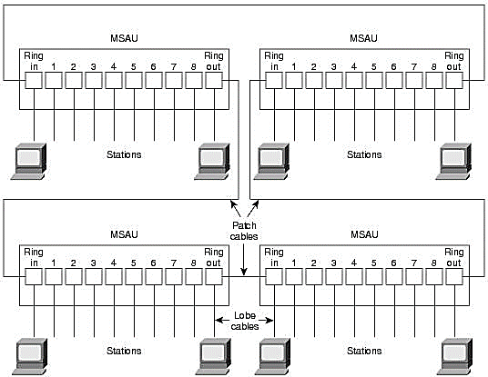
Physical Connection of Token Ring(802.5)
IBM Token Ring network stations are directly connected to MSAUs, which can be wired together to form one large ring (see Figure: MSAUs Can Be Wired Together to Form One Large Ring in an IBM Token Ring Network).
Patch cables connect MSAUs to adjacent MSAUs, while lobe cables connect MSAUs to stations. MSAUs include bypass relays for removing stations from the ring.

Slide 57
Token Ring Passing
Token Ring and IEEE 802.5 are two principal examples of token- passing networks (FDDI is the other). Token-passing networks move a small frame, called a token, around the network. Possession of the token grants the right to transmit. If a node receiving the token has no information to send, it passes the token to the next end station.
Each station can hold the token for a maximum period of time.
If a station possessing the token does have information to transmit, it seizes the token, alters 1 bit of the token (which turns the token into a start-of-frame sequence), appends the information that it wants to transmit, and sends this information to the next station on the ring. Therefore, collisions cannot occur in Token Ring networks. If early token release is supported, a new token can be released when frame transmission is complete.
Direction of Token

Slide 58
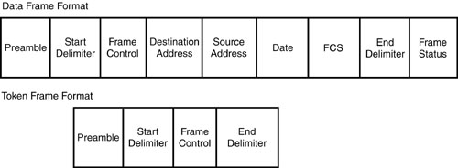
Token Ring frame format
Token Ring is similar to FDDI frames, in that they both support token formats, as well as data. Following figure illustrates the frame format of both the token being passed and a frame sent from a node on the ring during a Token Ring network communication.

Slide 59
Token Ring frame format (cont.)
Start Delimiter — Alerts each station of a token and uses a unique coding for the frame.
Access-Control Byte —
Contains a series of bits that circulate throughout the ring and are used by the active monitor to ensure delivery.
a Priority bit indicates the priority of the frame or token.
a Reservation bit indicates the priority required for the next token to gain access to the ring.
a Token bit differentiates a token from a data or command frame.
a Monitor bit determines whether a frame is circling the ring endlessly.
Active monitor employs a mechanism for detecting and compensating for network fault.

Slide 60
Token Ring frame format (cont.)
Frame Control — Indicates the frame type and contains the Frame type bit, the Reserved bit, and the Control bits.
Destination Address — Indicates the address of the receiver.
Source Address — Identifies the address of the sender.
Data — Indicates the actual data being sent from the upper layers.
Frame Control Sequence — Ensures that all the frames are delivered without damage.
End Delimiter — Defines the end of the token or frame and contains bits to indicate if a frame is damaged.
Frame Status — Terminates the frame and ensures that the frame has been copied to the destination address

Slide 61
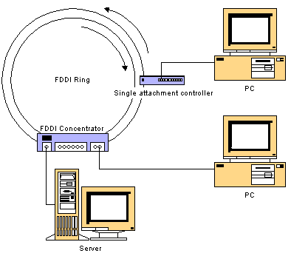
FDDI (Fiber Distributed Data Interface)
FDDI is a standard developed by the American National Standards Institute (ANSI) for transmitting data on optical fibers
Supports transmission rates of up to 200 Mbps
Uses a dual ring
First ring used to carry data at 100 Mbps
Second ring used for primary backup in case first ring fails
If no backup is needed, second ring can also carry data, increasing the data rate up to 200 Mbps
Supports up to 1000 nodes
Has a range of up to 200 km

Slide 62
FDDI access method
FDDI uses token passing as an access method similar to the IEEE 802.5 token ring.
Any station wants to transmit information holds the token and then transmits information and when it finish it releases the token in the ring.
The time a station holds the token is called Synchronous Allocation Time (SAT) and this time is variable for each station. The allocation of this time is variable to each station is achieved by Station Management (SMT).
The function of SMT are ring control, ring initialization, station insertion and station removal.

Slide 63
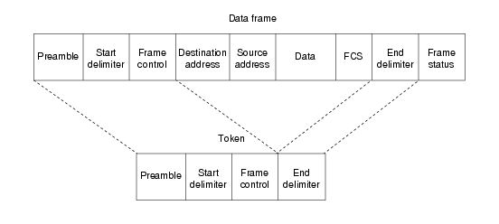
FDDI frame format

Slide 64
FDDI frame format (cont.)
The fields of an FDDI frame are as follows:
Preamble — Prepares each station for the upcoming frame.
Start delimiter — Indicates the beginning of the frame. It consists of signaling patterns that differentiate it from the rest of the frame.
Frame control — Indicates the size of the address fields, whether the frame contains asynchronous or synchronous data, and other control information.
Destination address — Contains a unicast (singular), multicast (group), or broadcast (every station) address. As with Ethernet and Token Ring, FDDI destination addresses are 6 bytes.
Source address — Identifies the single station that sent the frame. As with Ethernet and Token Ring, FDDI source addresses are 6 bytes.

Slide 65
FDDI frame format (cont.)
Data — Contains either information destined for an upper-layer protocol or control information.
Frame check sequence (FCS) — Filled by the source station with a calculated cyclic redundancy check (CRC) value dependent on the frame contents (as with Token Ring and Ethernet). The destination station recalculates the value to determine whether the frame may have been damaged in transit. If so, the frame is discarded.
End delimiter — Contains non data symbols that indicate the end of the frame.
Frame status — Allows the source station to determine if an error occurred and if the frame was recognized and copied by a receiving station.

Slide 66
Physical Medium Dependent (PMD) Layer
The Physical Medium Dependent layer defines the various cable specifications within the FDDI environment.
FDDI was initially engineered to use a type of fiber optic cable called MULTIMODE fiber. Today there are many other types of media being used which include SINGLE-MODE FIBER, UTP (Unshielded Twisted Pair), Category 5 shielded twisted pair, and Synchronous Optical Network (SONET).
PMD allows these various media to be standardized within FDDI by assigning an allowable ATTENUATION BUDGET between the transmitter and receiver.

Slide 67
Physical Medium Dependent (PMD) Layer (cont.)
PMD allows an optical transmitter and receiver to be in the electrical “OFF” condition by defining the parameters for an OPTICAL BYPASS – which cuts a device out of an optical ring through a physical light conduit that simply lets the light go from the receiver to the transmitter without actually being retransmitted by the LED (Light Emitting Diode) or LASER in the station.
The implementation of an optical bypass in an FDDI adapter card is optional. In this regard, by the way, PMD describes the energy output requirements for an LED or a LASER transmitter as well as the necessary sensitivities for a receiver system.

Slide 68
Thank you

